Slide 1

HTAP DB—System : ApsaraDB HBase Phoenix and Spark
Yun Zhang & Wei Li
August 17,2018

Slide 2
Content
01
Phoenix Over ApsaraDB HBase
Spark & ApsaraDB HBase/Phoenix
02

Slide 3
Phoenix Over ApsaraDB HBase
1

Slide 4
Content
1.1
Architecture
1.2
Use Cases
1.3
Best Practice
1.4
Challenges & Improvements

Slide 5
Phoenix Over ApsaraDB HBase
1.1

Slide 6
Phoenix-As-A-Service
Phoenix-as-a-service over ApsaraDB HBase
Orientations
Provides OLTP and Operational analytics over ApsaraDB HBASE
Targets
Make HBASE easier to use
JDBC API/SQL
Other functions
Secondary Index
Transaction
Multi tenancy
…

Slide 7
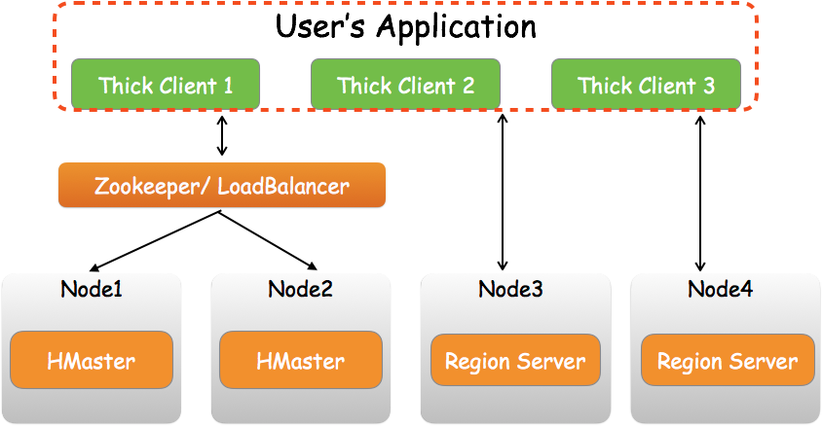
Phoenix Architecture
Thick Phoenix Client Architecture
Upgrades client is very painful as a cloud service!

Slide 8
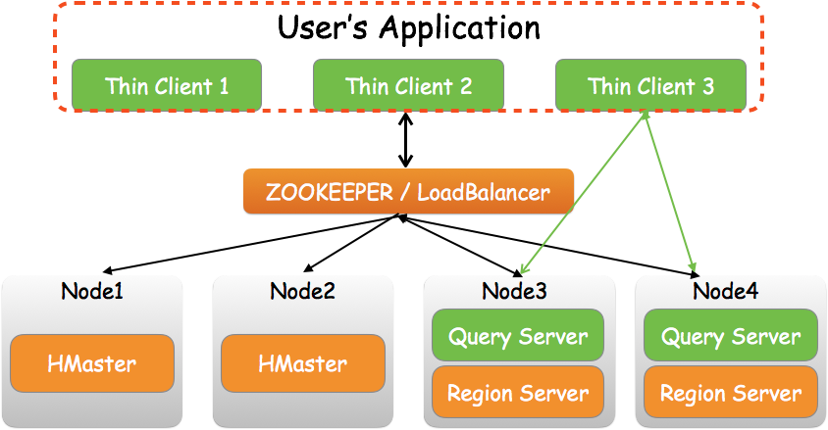
Phoenix Architecture
Thin Phoenix Client Architecture
Lower maintenance cost as a cloud service!

Slide 9
Use Cases
1.2

Slide 10
Use Case 1
LOT Scenario
Data
Big table(Spatial Temporal Data) 100 million+
Small table(User Information) less than 1 million
Functional Requirements
Hash join(big table join small table)
Staled table (avoid hot spotting)
Secondary index
Other Requirements
Latency less than 2 seconds (100 vertices of polygon)
Scale out

Slide 11
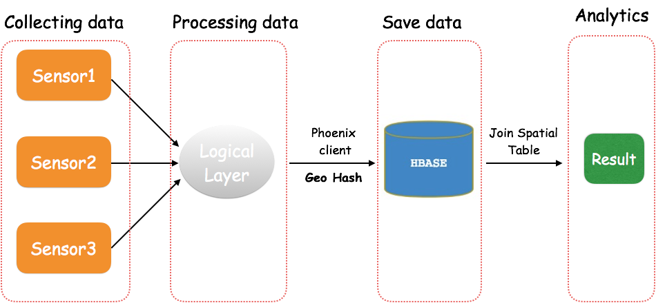
Use Case 1
Architecture

Slide 12
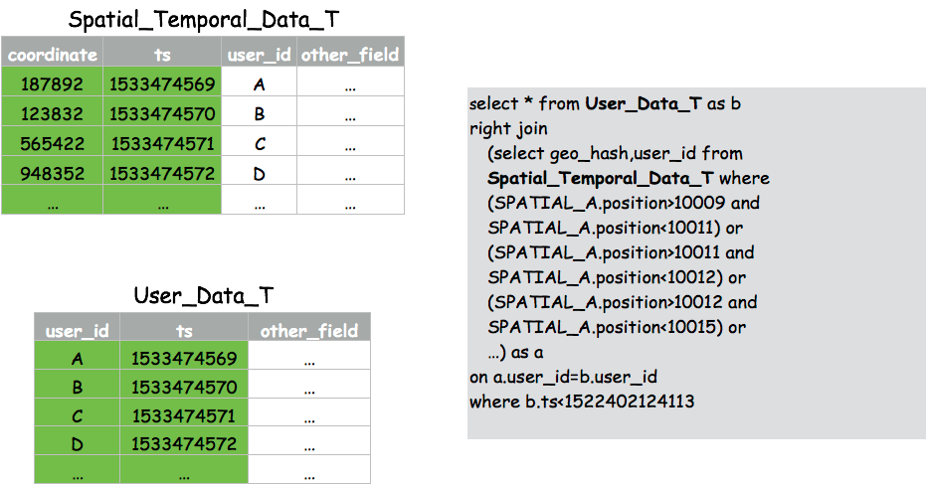
Use Case 1
Query

Slide 13
Use Case 2
Internet Company Scenario
Data
350+ million/per day
500G+/per day(uncompress)
Functional Requirements
Staled table (avoid hot spotting)
Secondary index(multidimensional analytics)
Other Requirements
Latency less than 200 Millisecond
6+ index tables
Scale out

Slide 14
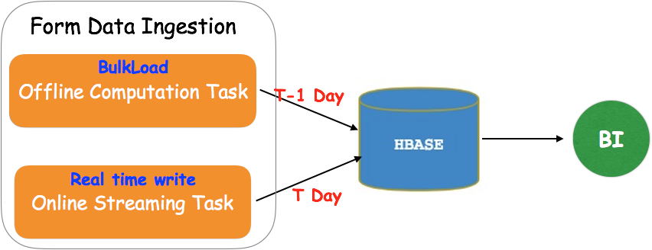
Use Case 2
Architecture

Slide 15
Best Practices
1.3

Slide 16
Best Practices
Table Properties
Recommend to set UPDATE_CACHE_FREQUENCY when create table (120000ms as a default value)
Used pre-splitting keys is better than slated table.(Range scan is limited when use slate buckets)
Pre-splitting region for index table(if your data tables are salted table, index tables will inherit this property).
SALT_BUCKETS is not equal split keys(pre-splitting region)!!!

Slide 17
Best Practices
Query Hint
Use USE_SORT_MERGE_JOIN when join bigger tables.
Use NO_CACHE will avoid caching any HBase blocks loaded, which can reduce GC overhead and get better performance. it is used export data query, such as UPSERT…SELECT clause.
Use SMALL will save an RPC call on the scan, Which can reduce network overhead. it is used hit the small amount of data of query.

Slide 18
Best Practices
Composite Key
Data table composite key | Index table composite key
CREATE TABLE DATA_TABLE( A VARCHAR, B VARCHAR, C VARCHAR, D INTEGER, CONSTRAINT PK PRIMARY KEY(A, B, C)) | CREATE INDEX IDX_NAME ON DATA_TABLE(A, B, C)
Where Conditions | Status
A=x and B=x and C=x | Best
A=x and B=x | Better
A=x | OK
B=x and C=x | Not recommended
C=x | Dangerous

Slide 19
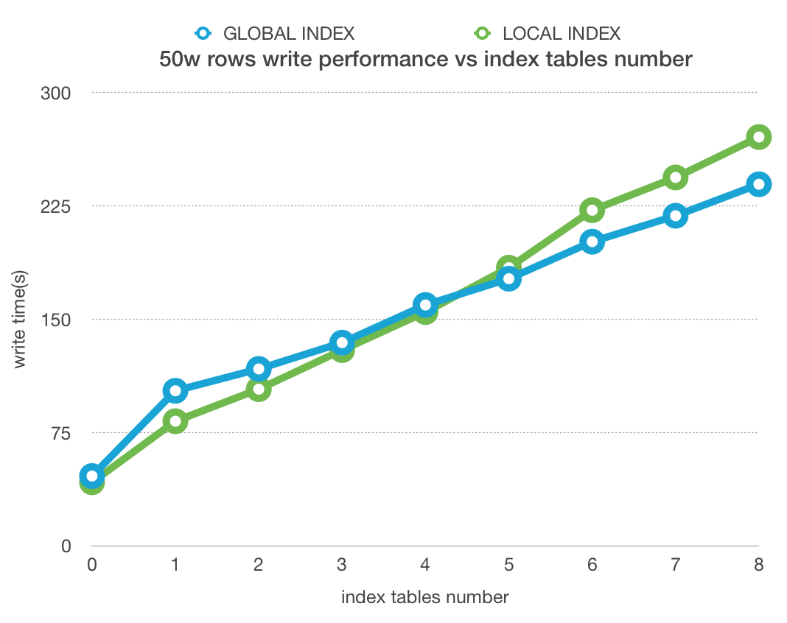
Best Practices
Other Tips
Recommend to use global index on massive data table
Reasonable to use Row timestamp that affects visibility of data
More index tables depressed write throughput

Slide 20
Challenges & Improvements
1.4

Slide 21
Challenges
Availability
Sometimes index table become unavailable.
Stability
Full scan/complex queries affects cluster’s stability
Users Complaints
queries can’t automatically choose the best index table
Using Python client get worse performance.
Lack of data transferring tools (data import/export)
Scarce monitor metrics
...

Slide 22
Improvements
Stability
Phoenix Chaos Monkey test framework
Availability
Support infinite retry policy when writing index failures to avoid degrade to full scan data table.
Producibility
Recognizes some full scan/complex queries and reject on the Server(Query Server) side
Integrate monitor platform
Other new features
Alter modify column/rename
Reports rate of progress When creating index

Slide 23
Spark & ApsaraDB HBase/Phoenix
2

Slide 24
Spark &
ApsaraDB HBase
2.1
Overview
2.2
Architecture & Implementation
2.3
Scenario

Slide 25
Overview
2.1

Slide 26

Overview
HBase/phoenix requirements
Why?
Analysis
1
Phoenix not good at complex analysis
2
Bulkload
Users need bulkload large number of data to hbase/phoenix fastly
3
Elastic resource
Phoenix uses hbase coprocessors to do analysis, but hbase cluster resource has limitation
4
Real time etl/load
As data visibility，user need realtime etl and load to hbase/phoenix

Slide 27
Overview
what can spark bring to ApsaraDB HBase
Analysis:
spark as a unified analytics engine，support SQL 2003
Use dag support complex analysis
Bulkload：spark can support multi datasource like jdbc, csv, elasticsearch, mongo; have elastic resource
Realtime load：struct streaming easy to do etl, and load to hbase
realtime
load
analysis
bulkload
build index
HBase/
Phoenix
spark
Spark
Compute resources

Slide 28
Architecture & Implementation
2.2

Slide 29
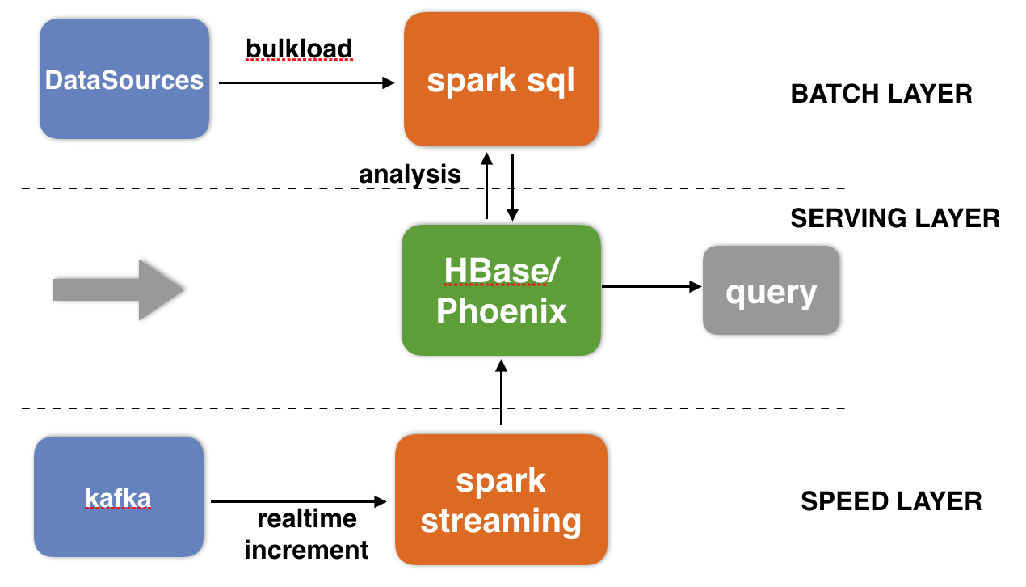
Architecture & implementation
Use ApsaraDB HBase and spark construct big data platform
BATCH LAYER : use spark sql/dataset analysis HBase/Phoenix, also bulkload other datasources to HBase
SPEED LAYER : use struct streaming etl data from kafka, and increment load into HBase
SERVING LAYER : User query result data from HBase/Phoenix

Slide 30
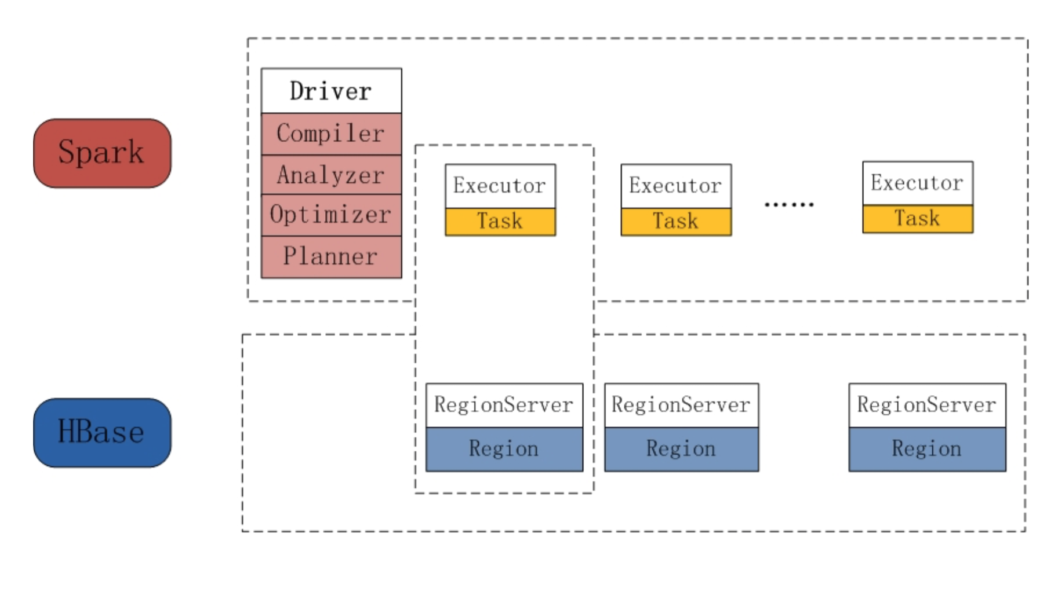
spark sql& HBase
how spark sql analysis HBase/Phoenix?
SQL API：use spark sql analysis hbase，table meta in hive metastore
Performance:
distributed scan;
sql optimize like partition pruning、column pruning、predicate pushdown；
direct reading hifles；
auto transform to column based storage

Slide 31
spark sql& HBase
demo:CREATE TABLE
CREATE TABLE HBaseTest USING org.apache.spark.sql.execution.datasources.hbase
OPTIONS ('catalog'=
'{
"table":{"namespace":"default", "name":”TestTable", "tableCoder":"PrimitiveType"},
"rowkey":"key",
"columns":{
"col0":{"cf":"rowkey", "col":"key", "type":"string"},
"col1":{"cf":"cf1", "col":"col1", "type":"boolean"},
"col2":{"cf":"cf2", "col":"col2", "type":"double"},
"col3":{"cf":"cf3", "col":"col3", "type":"float"},
"col4":{"cf":"cf4", "col":"col4", "type":"int"},
"col5":{"cf":"cf5", "col":"col5", "type":"bigint"},
"col6":{"cf":"cf6", "col":"col6", "type":"smallint"},
"col7":{"cf":"cf7", "col":"col7", "type":"string"},
"col8":{"cf":"cf8", "col":"col8", "type":"tinyint"}
}
}’
)

Slide 32
spark sql& HBase
demo and performance
beeline> select count(col2) from HBaseTest where col0 < 'row050‘ and col2 >’10.0
partition pruning：use col0 < ‘row050‘ to perform the needed regions
predicate pushdown：col2 >’10.0 filter will pushdown to hbase scan
column pruning: only scan the needed column
Performance:
Data scale:500208
Native HBaseRDD: HadoopRDD use TableInputFormat
Spark SQL:spark hbase datasource
类型 | 时间 | 结果
Native HBaseRDD | 14.425s | 5788
Spark SQL | 1.036s | 5788

Slide 33
Spark struct streaming& HBase
demo
val catalog = s"""{ |"table":{"namespace":"default", "name":"structStreamingCount", "tableCoder":"PrimitiveType"}, |"rowkey":"key", |"columns":{ |"value":{"cf":"rowkey", "col":"key", "type":"string"}, |"count":{"cf":"cf1", "col":"count", "type":"int"} |} |}""".stripMargin
val lines = spark.XXX.load() val wordCounts = lines.as[String].flatMap(_.split(" ")).filter($"value"=!="").groupBy("value").count() val query = wordCounts. writeStream. outputMode("update"). format("org.apache.spark.sql.execution.datasources.hbase.HBaseSinkProvider"). option("checkpointLocation", “xxxx"). option("hbasecat", catalog). start()

Slide 34
Scenario
2.3

Slide 35
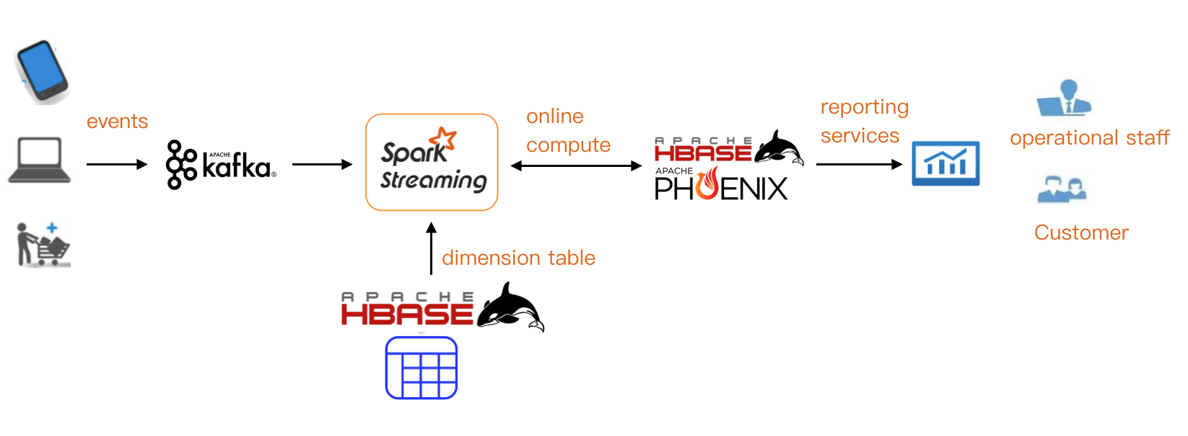
Scenario 1
big data online reporting services
Specialty
Online service
Dimension table
Case
Mobile game：Real-time user activity in different regions
Business：Different types of goods pv real-time report

Slide 36
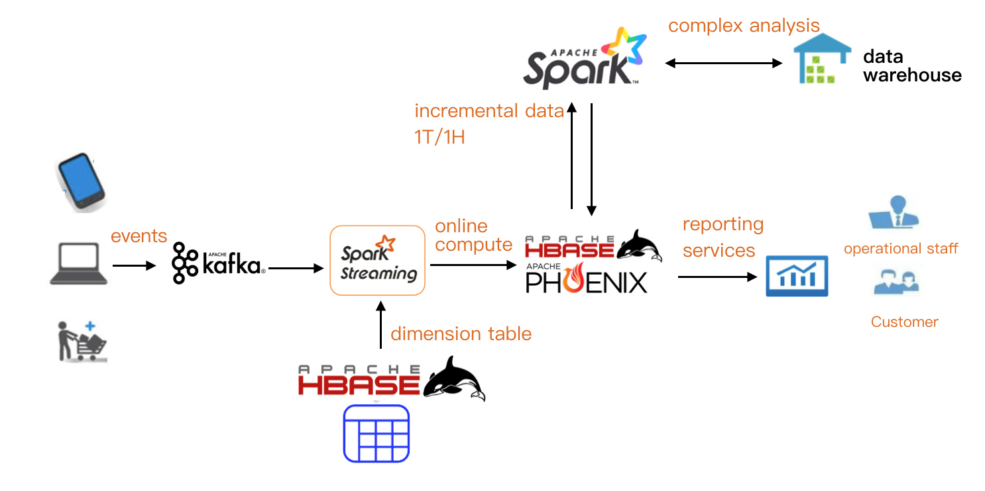
Scenario 2
big data complex reporting services
Specialty
Complex analysis
Datawarehouse
Quasi-real time
Case
Mobile game：Comparison of user activity in different age groups during the same period

Slide 37
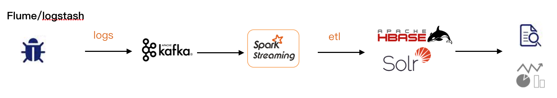
Scenario 3
log indexes and query
Case
Log service system
Specialty
collect logs in real time
log indexes and query

Slide 38
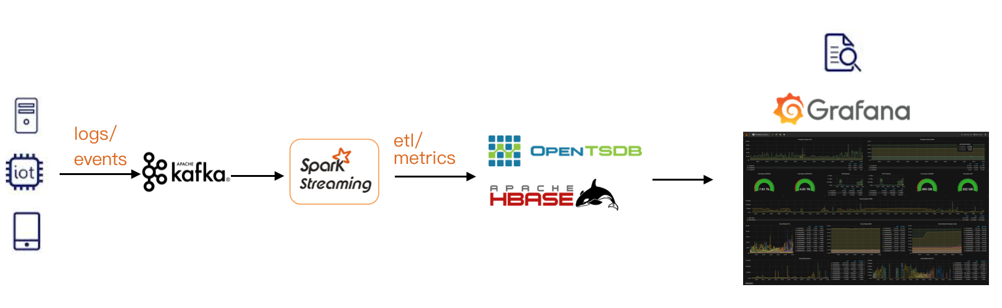
Scenario 4
time series query and monitoring
Case
IOT、service and business monitoring system
Specialty
Time series data
Multi metrics
Time series query

Slide 39



We are hiring!
If you are interested in the unified online sql analysis engine
If you are interested in the spark kernel and ecosystem
ApsaraDB HBase
DingDing Community
Yun Zhang (wechat)
Phoenix
Wei Li (wechat)
Spark

Slide 40
Thanks

